Slide 1
Liquidity Project for SEC
B3S: Basel2, Basel3 & Liquidity requirements

Slide 2
Agenda
Objectives
Business requirements
Functional architecture
Production Process
Basel2 Impacts
Basel3 & Liquidity
Process STP

Slide 3
Objectives
Present the impact and link with the current Basel2 application
Define the data for Basel3/Liquidity application
Impacts from upstream application (Antalis 3, SPV/CPC)
Define process

Slide 4
Agenda
Objectives
Business requirements
Functional architecture
Production Process
Basel2 Impacts
Basel3 & Liquidity
Process STP

Slide 5
Liquidity project- Requirements
FSA (Delivered from January 2012)
Required contractual for SGPM
Basel 3: Contractual flow at specific date for SG (Delivered from January 2012)
Contractual gaps
Calculate liquidity ratio: LCR & NSFR
Ratios are calculated by DEVL at different level: business unit, department and Group level
Internal method (ACP): Calculate liquidity gaps for securitization conduits
Based on static and dynamic portfolios (= stock deals + new production)
Gap static & gap dynamic
Based on several scenarios: business as usual, stressed environments
BAU static ror SGBN delivered on June 2012
BAU dynamic for Entity level only
Frequency
Monthly basis from now on and weekly basis on target
« On-demand » (end of month, specific request …)
Scope
Sponsored non consolidated conduit: Antalis, Barton (Ace & Homes)
Entity: SGBN and SG Milan
SGBN managed from June 2012
SG Milan to be plan

Slide 6
Scope expected by DEVL
Portfolio Static | BASEL3-LCR NSFR | Internal Method
 | BASEL3-LCR NSFR | BAU |  | SSG | MPL | CMB
Conduit | x
Entity | x | x
Portfolio Dynamic | BASEL3-LCR NSFR | Internal Method
 | BASEL3-LCR NSFR | BAU |  | SSG | MPL | CMB
Conduit |  |  |  | x | x | x
Entity |  | x

Slide 7
Agenda
Objectives
Business requirements
Functional architecture
Production Process
Basel2 Impacts
Basel3 & Liquidity
Process STP

Slide 8
Liquidity project-Functional Architecture
Model parameters settings (DEVL referential)
Antalis 3 (EUROPE and ASIA)
CPC On-Track / SPV Management (AMER)
BDR
Web Service
Inputs module
CPM
Scheduler
B2S Launcher
+ Data Control
Liquidity Launcher + Data Control
B2S Engine
User Rights Module
Structured Finance Liquidity Calculator
Data administration
B2S outputs module
Liquidity outputs module
Manual inputs
(model parameters,
new production)
Simulation Module
Securitization Liquidity Engine
B2S Send to Collecte
Liquidity Send to SGCIB Collector
Adjustments
if any
1 file per geographic area (US, Europe, Asia)
Securitization
perimeter
FSI
Liqor
(SGCIB Collector)
Collecte
Basylic
(DEVL Collector)
Liquidity needs for GLFI perimeter (including Securitization)
Basel 2 calculation
Liquidity calculation

Slide 9
Liquidity project-Functional Architecture
Antalis & SPV/CPC
Application of management of deal & funding
B2S becomes B3S
Basel2 management for RWA of securitization perimeter
Sent to Collecte
Before sending to collect there is a reconciliation with LOAN IQ, manage by FSI
Liqor
This is the SGCIB liquidity platform
Ensure the liquidity calculator for MARK
SGCIB application don’t communicate directly with Basyliq

Slide 10
Liquidity project-Functional Architecture
Basyliq
This is the group application in charge of reporting for all regulator requirements
Declaration of FSA, Basel3 (LCR, NSFR, gap static) & internal monitoring
Results will be available at different Level
Group
Business line

Slide 11
Securitization scheme
Interco flow
External flow
Asset
FCT
(non consolidé )
Conduit de titrisation
Client 1
CP
Investisseur
Cash
SGBN
Deposit
Funding
Créances
CP
Investisseur
Client 2
Cash
Deposit
Funding
Asset
CP
Investisseur
Client 3
Asset
SG Milan
Cash
Funding
Cash
Asset
FCC Albatros
(Consolidé)
Titles
Credit Line
Lignes de liquidité du conduit
Client 4
1 LL per deal (client)
of SG Paris or SG NY of the conduit
- 1 LL per deal (client)
of SG Paris to SGBN
1 LC per conduit for SGNY
1 LC per deal for Europe
Cash
Cash
Liquidity Line for SGBN
SG Paris ou SG NY

Slide 12
Agenda
Objectives
Business requirements
Functional architecture
Production Process
Basel2 Impacts
Basel3 & Liquidity
Process STP

Slide 13
Process-Production planning
Switch to Amortizing feature production release expected on 16th July-2013
Liquidity run
Data Based on 31st July 2013 is expected by DEVL
On wednesday 31st July 2013
Create assessment date on 31st July 2013
Set the switch to Amortizing flag value for the first imported period and then on all subsequent deal periods the flag value will be defaulted on loading.
Launch complete calculation for Liqor Sending: Basel3, ACP-IM on 4 scenarios (BAU, Stress1- SG Specific; Stress2-Systemic; Stress3-Combined)
On Thursday 1st Aug send to Liqor

Slide 14
Process- Set Administration Basel3 parameter
Set Administration data for conduit
Conduit elementary name
Booking entity
Set Administration deal
Final client and final client type should be checked/set (static value)
Deal sharing ratio should be checked
Notice Period should be defined if required
In administration, for each conduit one portfolio for official calculation should be defined.
One official portfolio for Antalis, Barton, Ace Raroc, Homes Raroc
➔ These value should be constant

Slide 15
Process- Set Administration Internal Method parameter
Set Administration data for conduit
Liability to receivables Ratio Floor
Haircut Ratio for CP Repoed if required (at present, to be settled for all liability and calibrated currencies)
Set Administration deal
Check that deal closing date is updated
Asset type
New production flag
Set Administration facility
Mind to link one or many « New Production » facilities to each new production deal
Mind to set the facility type correctly and check that facility is valid
In administration, for each conduit one portfolio for official calculation should be defined.
One official static portfolio
One official Dynamic portfolio

Slide 16
Process-Production Actions facility management
Each deal submitted to Liquidity calculation should be linked to one valid facility at least
For Telecom Italia deal
Facilities currently attached to Telecom Italia deal under Antalis Bis conduit should be attached to only one deal Telecom Italia under Antalis conduit
RWA for Basel2 calculation should be set to 0 in Frasles application
Calculation for deal which are linked to several facility based the ratio per facility on facility amount
Facility amount should be updated depending on facility amount modification (quarterly for Europe)

Slide 17
Process-Production Actions Input management
Finally for Basel 3, required input data are
For deal level
Program limit (maximum amount)
Bank funding (amount used by the client)
Commitment maturity date =max(LL maturity date , Deal maturity date)
All deals should be linked to facility for which one the amount should be updated when the amount are modified
P&L sharing should be set
Receivables Purchase Calendar
For conduit level
Cash flow calendar of CP Regular
Set parameter
Counterparty & Booking
Define Client & client type

Slide 18
Process-Production Actions Input management
For BAU Internal Method, required input data are
At deal level
All the data required for Basel 3 are also required for SGBN BAU calculation
On top of that, additional data are expected
Amortizing Type (Revolving/Amortizing)
Deal Renewal Status and Renewal Commitment Maturity Date
For revolving deal the ‘Switch to Amortizing’ status
Advance Rate (=Bank Funding/Closing Balance)
Amortizing Profile (of deal’s assets)
Payoff Profile (decrease of the deal’s Program Limit)
Usage Profile (defined for one year or until deal’s Commitment Maturity Date / Renewal Commitment Maturity Date)
At conduit level
No additional data required in comparison to Basel 3 inputs

Slide 19
Process-Production Actions Input management
For Stressed Internal Method, required input data are
At deal level
All the data required for BAU Internal Method are also required for Stressed Internal Method calculation
At conduit level
All data required for Basel 3 are also required for Stressed Internal Method calculation except the Receivables Purchase Calendar
On top of that, additional data can be inputted depending on the assessment date situation:
Cash flow calendar of CP Retained
Cash flow calendar of CP Repoed
Cash flow calendar of Prefunded
Drawn amount per LL (not handled currently)

Slide 20
Agenda
Objectives
Business requirements
Functional architecture
Production Process
Basel2 Impacts
Basel3 & Liquidity
Process STP

Slide 21
Liquidity project- Basel2 application impacts
Only one application to connect under Basel2 or Liquidity application: B3S
User can be assigned to basel2 or liquidity application independently. That mean one user can access to Basel2 or/And Liquidity modules.
Some modules of B2S are not impacted by the development of Liquidity:
Send to Collect
Credit Workflow
Input Management
Rating management
Calculation
Result Monitoring

Slide 22
Liquidity project- Basel2 application impacts
Some data are commons of both requirements
Connection parameter (Home)
Administration
Input Load Data
 | Liquidity | Basel2 | Comments
Administration-BL and Area setting | Used | Used | No modification
Administration-Conduit and Deal | Used | Used | New fields added to reply at Liquidity constraints (referential data). Some fields are specific to Basel2 or Liquidity needs and some are common
Administration-Facility management | Used | Used | Adding trust notion to manage Australian deal
Administration-Basel2 Model parameter | Unused | Used | No modification. Available only for B2S
Administration-Statement Periods | Unused | Used | No modification. Available only for B2S
Administration-Credit workflow management | Unused | Used | No modification. Available only for B2S
Input Data- Load Data | Used | Used | Each module gets its own load data. Once of B2S has been improved

Slide 23
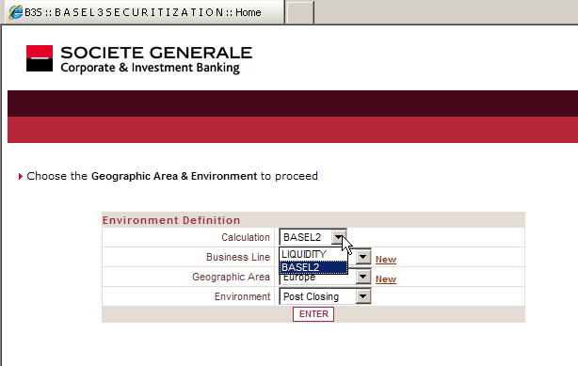
Liquidity project- Connection parameter
Calculation Type: allow to define under which module user will be log and access to specific data linked to it
User can be B2S OR/AND Liquidity user
This parameter is defined under SGH

Slide 24
Liquidity project- Administration
The data in administration module are not in the upstream application (Antalis & CPC). B3S is considered as master for that
Data are static and not linked to the assessment
Need to be reviewed rarely
The dynamic data linked to assessment date are also integrated in upstream application

Slide 25
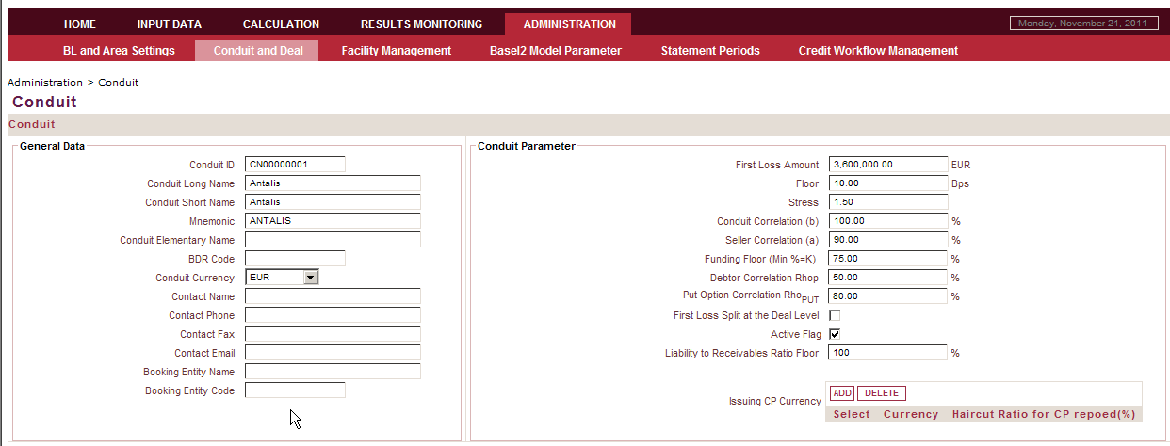
Liquidity project- Administration>Conduit
Conduit elementary Name: define on which counterparty the LL/ CP are booked. This is an elementary level (constraint from Liqor)
BDR Code: automatically fed by the BDR Code of elementary level selected as Conduit elementary level
Booking entity name: Define on which booking LL/CP are booked (SG Paris, SG NY). This is an elementary level (constraint from Liqor)
Booking entity code: automatically fed by the BDR Code of elementary level selected as Booking entity name
Liability to receivables ratio floor: can be > 100% as the interest of liabilities should be take into account (include interest) or < 100% due o favorable foreign exchanges rate variations. Set by Front Office/DEVL. Can be set to 100% for beginning as it will be useless for BA3
Issuing CP Currency: define for each currency the haircut ratio that should applied for Repoed CP. It’s defined per conduit and per currency. Hair cut set by Front Office/DEVL
B3
&
IM
IM

Slide 26
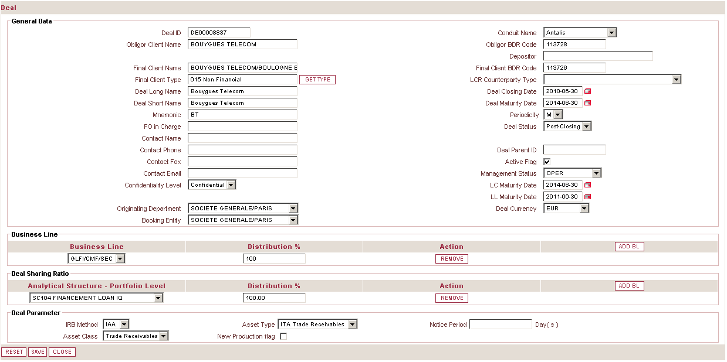
Liquidity project- Administration>Deal
Deal has been impacted at different level
General data: with Final client name, final client type & LCR counterparty type notion
Business line: P&L sharing for liquidity cost has been added
Deal Parameter: with the Asset type, Notice Period and New production flag

Slide 27
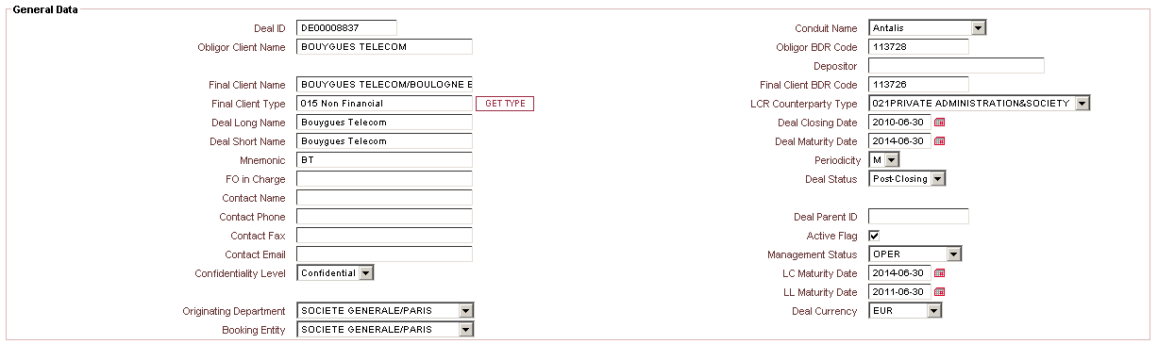
Liquidity project- Administration>Deal>General
Client name has been renamed by Obligor client name and Obligor BDR Code.
This field define the Obligor off of the deal. This counterparty is used for CWF sent
Final client name: Define the seller of the deal. This is elementary level (constraint from Liqor)
Final Client Type: automatic feeding. Click on Get client type button to retrieve automatically from BDR the regulatory client type (CTR).
Final Client BDR Code: automatically inputted with the selected final client name
Final
LCR Counterparty Type: Due to structuration of the deal, the deal can get a type different than the client type. Thanks to the value selected in LCR Counterparty Type, the correct value will be sent to DEVL. If the value in BDR is not correct, the modification request should be done to BDR
B3
&
IM

Slide 28
Liquidity project- Administration>Deal>Deal Sharing Ratio
To remove added line
To add new line
Deal sharing ratio: represent the risk or P&L sharing of the deal per business Line ➔ This point should be decided by FO in collaboration with GLFI/DIR and DEV. This is a Portfolio level of the BDR analytical structure.
Distribution %: represent the percentage of the sharing
B3
&
IM
Asset Type: this the mix between asset class and Nationality. For instance: Loan-US, Trade Receivables EUR. The liquidity drawdown behavior of the calibration will be defined per asset type. Set by Front Office at inception of a deal
New production: Represent the pre-closing deal. Including new production deals anticipate the liquidity risk with the known future scope. Info will be transmitted by Front Office.
IM
Notice Period: Indicates the number of days of notice the client has to provide before drawing a portion of the unused commitment
B3

Slide 29
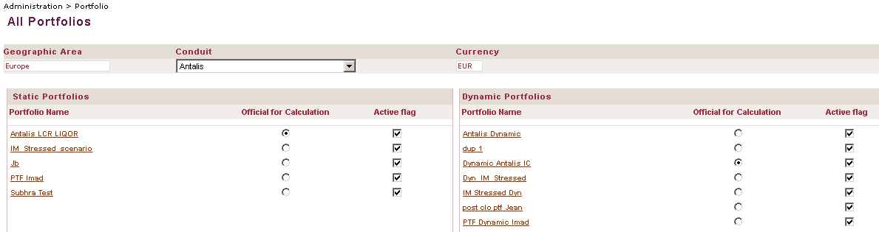
Liquidity project- Administration>Portfolio
Portfolio: is sub set of Conduit. It composed of deal from same conduits.
Static/Dynamic: Static portfolio only reflects the current portfolio as it is on the assessment date whereas dynamic portfolio reflects what the portfolio is realistically expected to be, in a later period, for projection purposes. Dynamic portfolio includes static deals and dynamic deals (future deals or current deals with renewal assumptions)
Official for Calculation: Define the portfolio will be used for automatic calculation.
Only one official portfolio per conduit can be selected. Official calculation for the automatic load data is requires
B3
&
IM

Slide 30
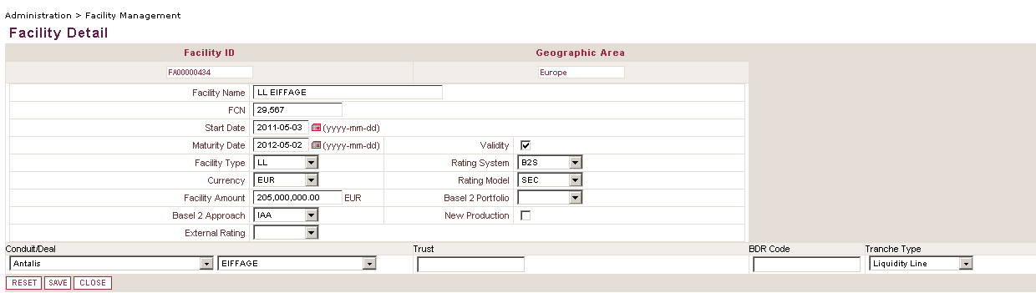
Liquidity project- Administration>Facility Management
New Production: This flag should be set on each facility linked to a new production deal.
IM

Slide 31
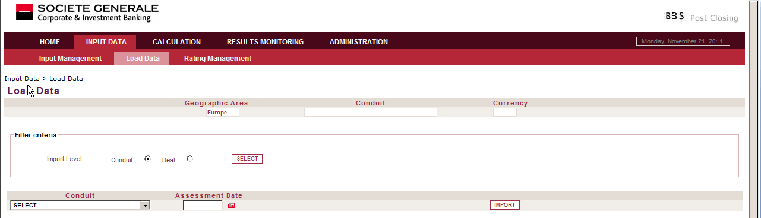
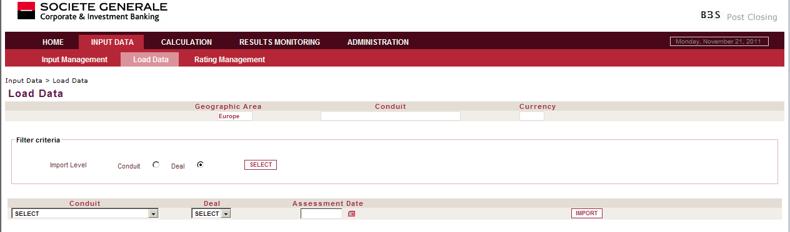
Liquidity project-Input Data> Basel 2 Load Data
Retrieve automatically data from upstream application at specific assessment date. Can import data at two levels:
Conduit: all deals belong to the conduit and present in upstream application will be updated
Deal: import data deal per deal.
If some issues are met during import, Auto input loader report is available to check the error. (Business Object report)
B3
&
IM

Slide 32
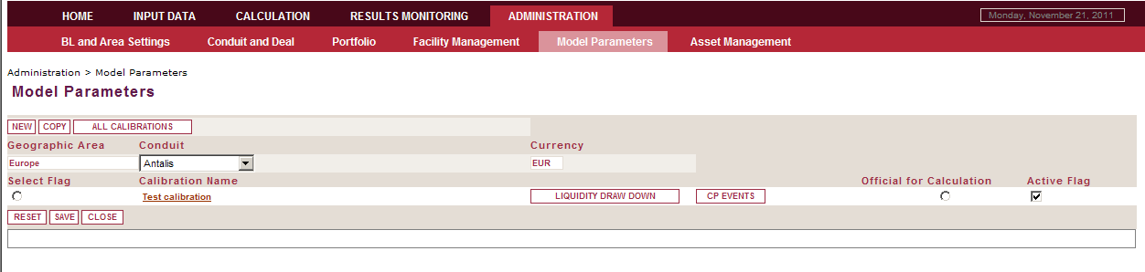
Liquidity project- Administration>Model Parameters
The application of the scenarios to the conduit activity is based on expert judgment and relies on the financial crisis history and experience. The scenarios are translated into the five types of liquidity sources: 1/ CP placed on the market, 2/ CP Repoed, 3/ CP Retained, 4/ CP Prefunded, 5/ Liquidity drawdown. They are all defined at the conduit level except for liquidity drawdown which is defined at asset type level. They are expressed through time buckets and as percentages of financing amounts.
All those parameters taken together represent a calibration, which will be applied to the conduit’s portfolios. They are the drivers of the deformation of the contractual cash flows into expected cash flows.
IM

Slide 33
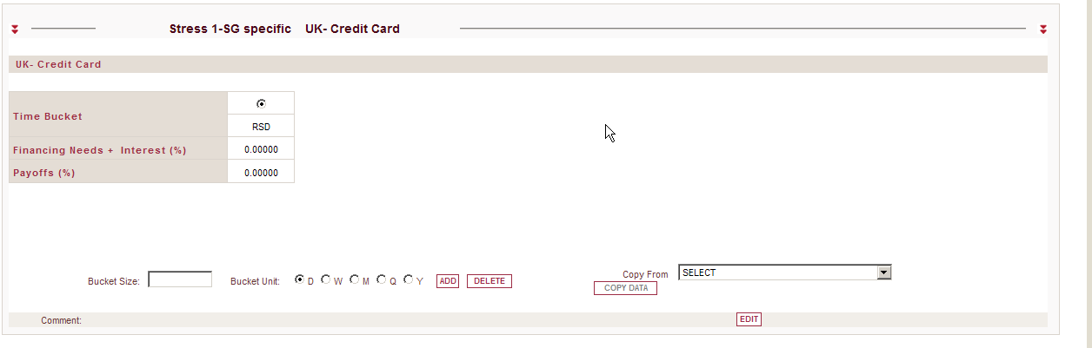
Liquidity project- Administration>Model Parameters>Liquidity drawdown
Represent Liquidity line given to the client. For a structural point of view the liquidity line is at deal level
Liquidity Drawdown is defined by asset type and applied specifically to the total financing needs of each facility
Allow to describe per asset type and per scenario the percentage of the liquidity drawdown
IM

Slide 34
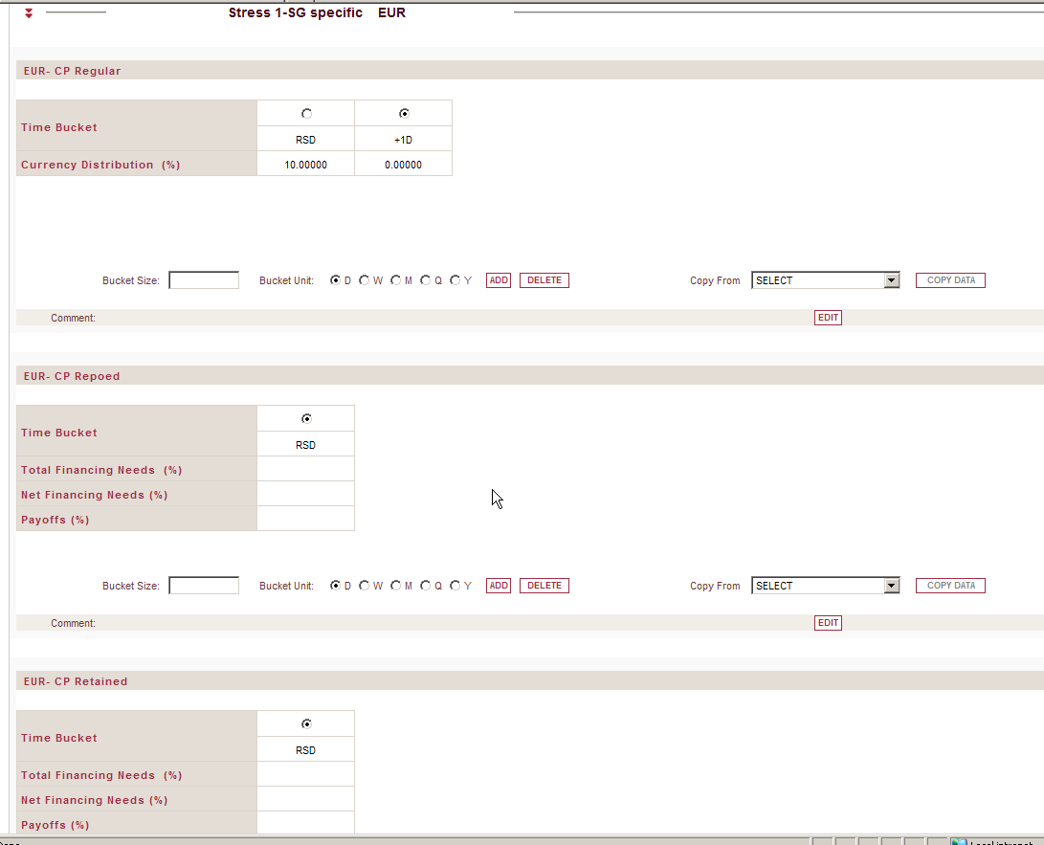
Liquidity project- Administration>Model Parameters>CP Events
Describe what percentage of the conduit’s liabilities each liquidity source will represent for each day in the future. It is defined per CP Type
CP Regular: CP placed on the market
CP Retained: put on SG balance sheet because conduit are sponsored
CP Repoed: bought by BCE/FED
The percentage contribution can be defined on the basis of total financing needs or net financing needs
IM

Slide 35
Agenda
Objectives
Business requirements
Functional architecture
Production Process
Basel2 Impacts
Basel3 & Liquidity
Process STP

Slide 36
Liquidity project-Input Data-Liquidity Load data
Import data from upstream for liquidity data at specific assessment date can be import at conduit level only
All input data will be fed by the upstream application
Per conduit the official for calculation portfolio should be defined (administration level)

Slide 37
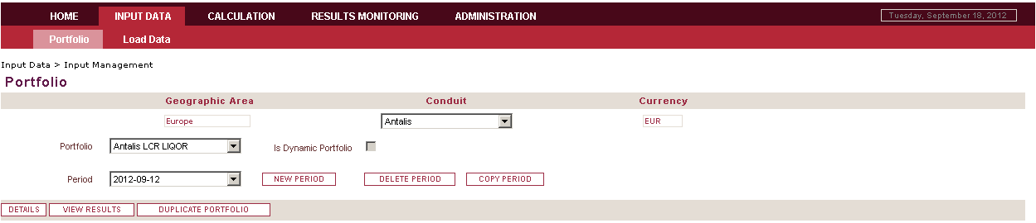
Liquidity project-Input Data> Portfolio
Portfolio is characterize by an assessment date
The portfolio scope can be different at each assessment date
Data of each deal can be different at each assessment date
Portfolio functionalities
New Period : create a new period for the portfolio
Duplicate Portfolio create a copy of initial portfolio at selected new assessment date
Copy period create a new assessment date for the selected portfolio with data copied from existing period
View result : display result linked to the portfolio at the selected assessment date
Details: displayed the input data linked to the portfolio at the selected assessment date
B3
&
IM

Slide 38
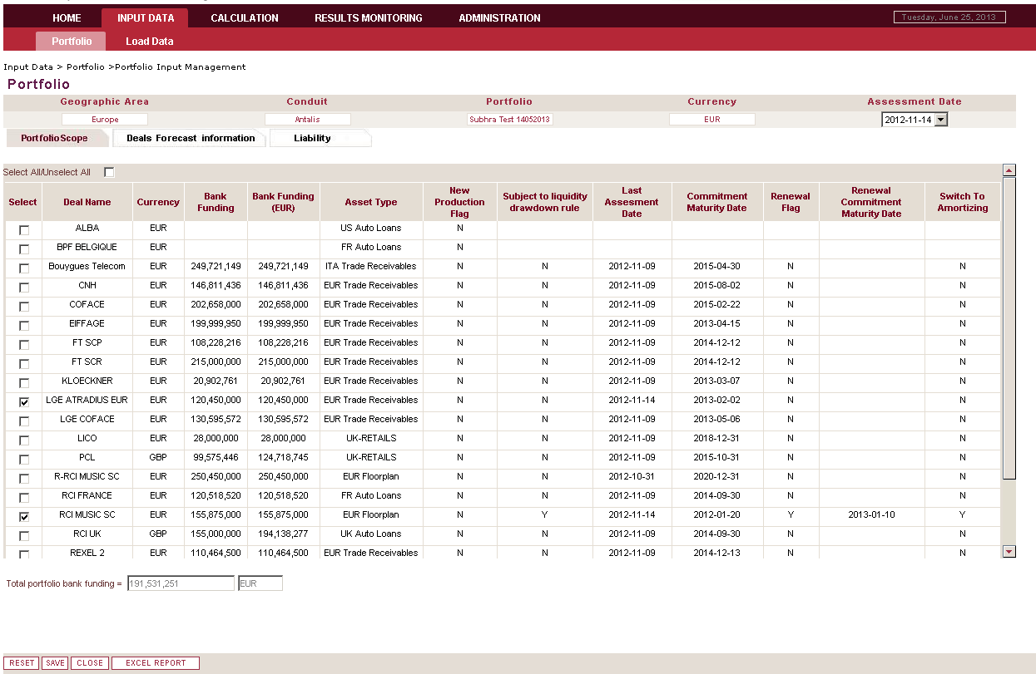
Liquidity project-Input Data> Portfolio>Input Management>Portfolio scope
Define the portfolio scope at a specific assessment date
Indicates if the deal is a Renewal deal and displays the original and the Renewal commitment maturity date
Indicates the status of the Switch to Amortizing flag for the deal. For revolving deal a deal can be marked for switch to amortizing
B3
&
IM
This screen is displayed when you have selected one portfolio, one assessment date and you click on Detail button
Is the sum of all bank funding deal which composed the portfolio.
The bank funding amount are converted to the portfolio currency (Equal to the conduit currency of the portfolio)
Excel report to extract the portfolio contents

Slide 39
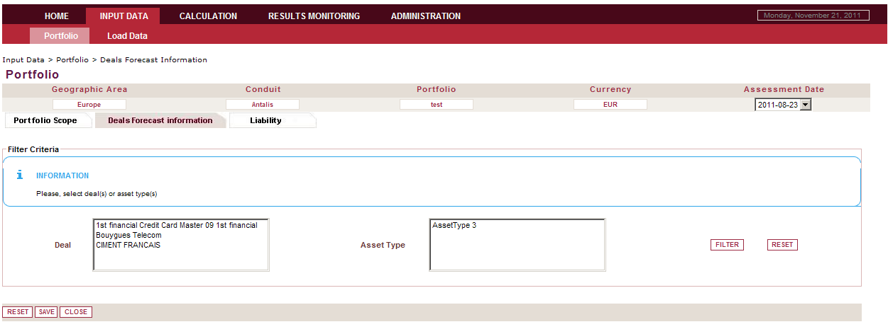
Liquidity project-Input Data> Portfolio>Input Management>Deal Forecast information (1/11)
B3
&
IM
Filter the deal by deal name or asset type
Impossible to filter by Deal And Asset type
Multiple selection for deal or for asset type is available
Search concerned the selected portfolio at the specific assessment date

Slide 40
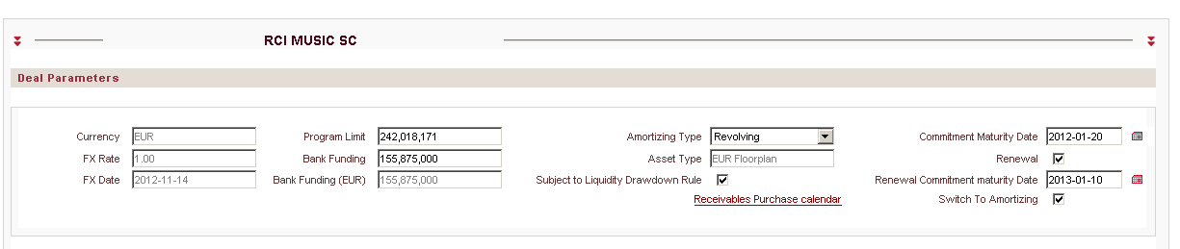
Liquidity project-Input Data> Portfolio>Input Management>Deal Forecast information (2/11)
Program Limit: max amount that the client can be used
Bank funding (= Receivables balance for AMER) : amount used by the client at the assessment date.
Commitment Maturity Date: max(Deal maturity date, Liquidity line maturity date)
Currency: deal currency. [Automatically fed]
FX Rate: Deal currency/Portfolio currency. Automatically retrieved from BDR. This is the last available monthly rate provided by BCE. [Automatically fed]
FX Date: Date of the FX Rate. [Automatically fed]
Bank Funding (XXX): conversion of the bank funding in portfolio currency. (XXX=portfolio currency). [Automatically fed]
Receivables Purchase Calendar: Calendar that contains the know future receivable purchase from the client
B3
&
IM
Amortizing type: Amortizing or revolving. Define the type of the deal. Set at inception or renewal of the deal
Asset type: Define in administration module. [Automatically fed]
IM

Slide 41
Liquidity project-Input Data> Portfolio>Input Management>Deal Forecast information (2/11)
Deal Renewal: Indicates if the deal is to be renewed
Renewal Commitment Maturity Date: For a renewal deal the new commitment maturity date [considered only for dynamic portfolios- Remove the previously created Renewal deals from the dynamic portfolio scope and include the Renewal Commitment Maturity Date in the original deal]
Currently the Deal Renewal and Renewal commitment maturity Date data is not available in upstream application and need to be set manually for the first time. For subsequent uploading of data the two fields are defaulted from the last period.
Switch to Amortizing Flag: Flag Active for ‘Revolving’ deals to indicate whether the deal will be switching to amortizing or not. The switching date is the commitment maturity date / Renewal commitment maturity date or the first liquidity drawdown date.
Currently the ‘Switch to Amortizing’ flag data is not available from the upstream application and is defaulted from the last period for each of the deal period during the loading process.
IM

Slide 42
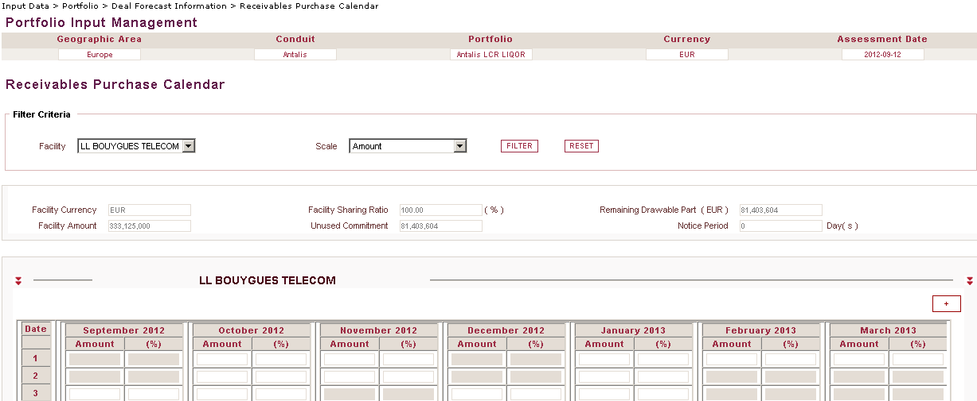
Liquidity project-Input Data> Portfolio>Input Management>Deal Forecast information (3/11)
Facility: In case of multi-facilities deal, Receivables Purchase Calendar will be defined per facility
Scale (Amount/Percentage): Future receivables purchase can be defined in “amount” or in “percentage” of the remaining undrawn amount on day n. At present, only “Amount” scale is secured.
Facility Currency / Facility Amount / Notice Period: Those values come from « Administration>Facility Management »
Facility Sharing Ratio: Sharing ratio is proportional to the facility commitment over the deal Program Limit
Unused Commitment: It is the deal’s facility potential drawable amount as per the assessment date
B3
&
IM
Remaining Drawable Part (<Facility CCY>): Remaining drawing capacity of the facility
BA3

Slide 43
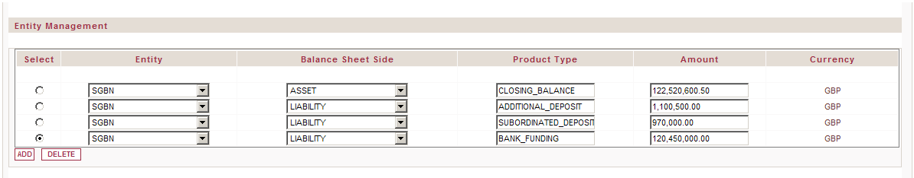
Liquidity project-Input Data> Portfolio>Input Management>Deal Forecast information (4/11)
Entity management concerned deal which through by another entity than Conduit
As of today, only Europe is concerned for SGBN & SG Milan. But the only entity in the scope is SGBN for the moment
At present, only RCI Music, KLOCKNER and TRAFIGURA are excluded of SGBN B/S
Entity: suggestion box to select concerned entity of the deal. (Elementary level)
Balance sheet side: Dropdown list : Asset/Liability
Product Type: free text to define the kind of Asset/Liability
Amount: free text
Currency: Automatically fed with the deal currency
B3
&
IM

Slide 44
Liquidity project-Input Data> Portfolio>Input Management>Deal Forecast information (5/11)
Entity Advance Rate is defined as the deal’s Bank Funding over Closing Balance of the deal on the Entity B/S. It is used to forecast the Entity Closing Balance during the scenario run
User may set as many Advance Rates as the number of Entities implied in the deal’s structure
In case of multiple Entities in the deal’s structure (e.g. SG Milan + SGBN), there is no dependency between each Advance Rate value
Entity: suggestion box to select concerned entity of the deal. (Elementary level)
BDR Code: BDR Party Id of the Entity selected
Advance Rate: Bank Funding / Closing Balance
IM

Slide 45
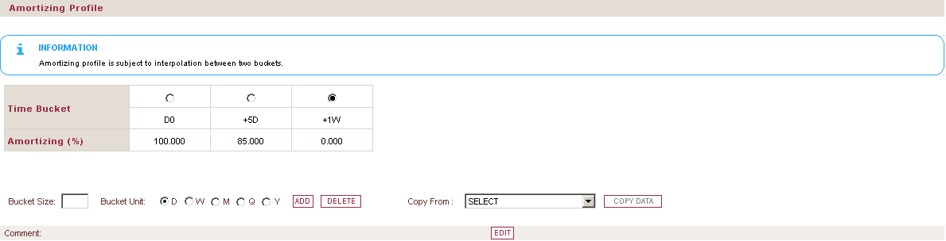
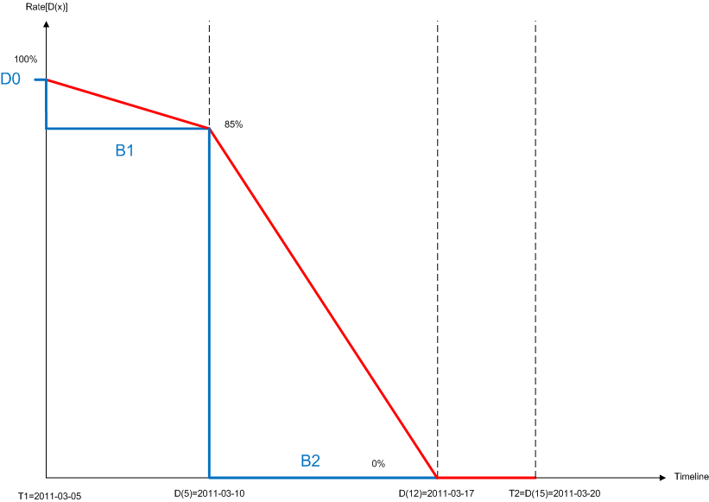
Liquidity project-Input Data> Portfolio>Input Management>Deal Forecast information (6/11)
Only mandatory for amortizing deal and revolving deal with STA=Y
Amortizing Profile describes the amortization of the deal’s assets starting from Max{Closing Date, Run Start Date}
Engine will automatically perform an end of bucket interpolation depending on the inputted buckets
Bucket Size: Length of the bucket
Bucket Unit: Unit of the Bucket Size (D=Day,W=Week,M=Month,Q=Quarter,Y=Year)
Amortizing (%): Percentage rate based on the initial Program Limit
IM

Slide 46
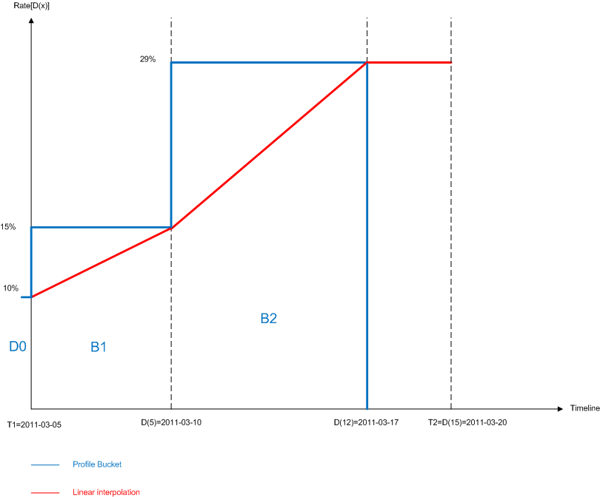
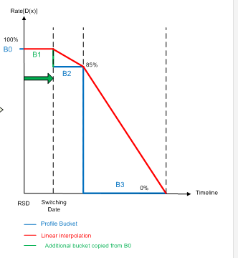
Liquidity project-Input Data> Portfolio>Input Management>Deal Forecast information (7/11)
Amortizing Profile automated rules:
If the profile is not defined until the deal’s CMD, then Engine will make it last constantly
For sake of LIQOR sending, if Basel 3 and IM are requested at the same time, the first bucket D0 will be forced to 100%
If amortizing rate reaches 0%, it will not go up again
For revolving deals with switch to amortizing =Y, an additional bucket will be inserted on switching date with amortizing rate = rate on D0

Slide 47
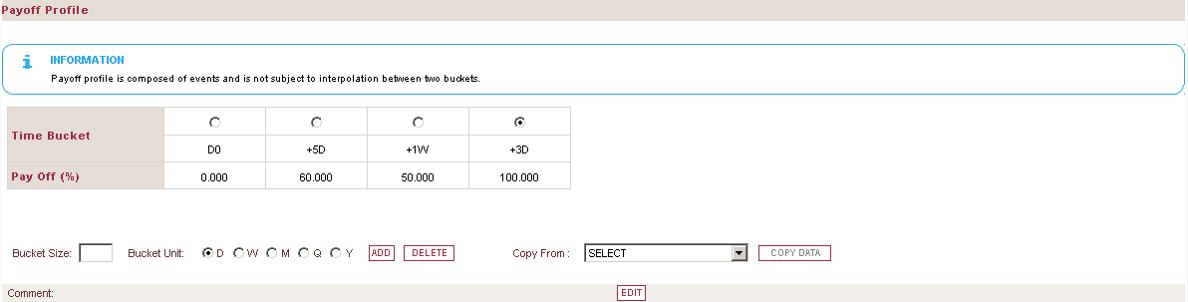
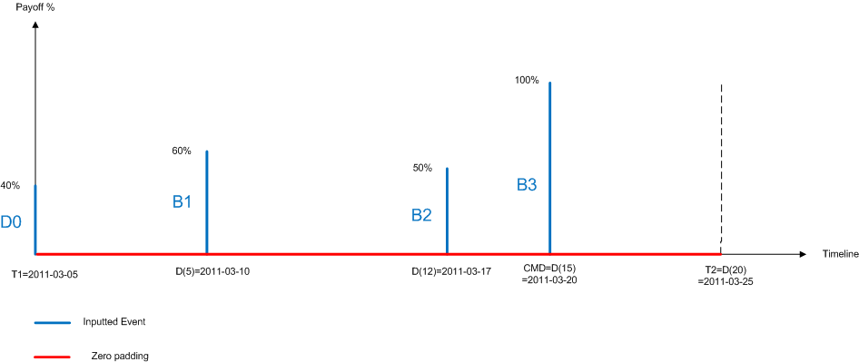
Liquidity project-Input Data> Portfolio>Input Management>Deal Forecast information (8/11)
Payoff Profile is a decrease event of the deal’s Program Limit
Payoff Profile starts from Max{Closing Date, Run Start Date}
Bucket Size: Length of the bucket
Bucket Unit: Unit of the Bucket Size (D=Day,W=Week,M=Month,Q=Quarter,Y=Year)
Pay Off (%): Percentage rate based on the previous Program Limit value (adjusted for past payoffs and amortizing)
IM

Slide 48
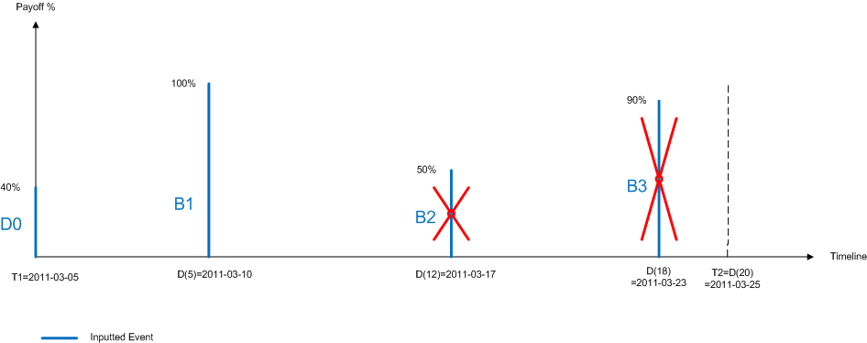
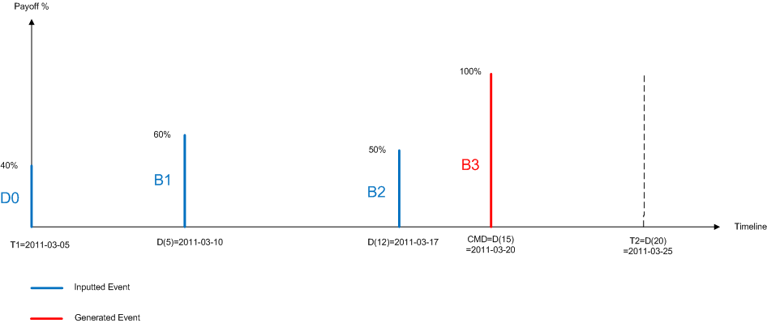
Liquidity project-Input Data> Portfolio>Input Management>Deal Forecast information (9/11)
Payoff Profile automated rules:
All payoff events that occur after a complete payoff of the deal (100%) will be removed
For sake of LIQOR sending, if Basel 3 and IM are requested at the same time, the first bucket D0 will be forced to 0%
A deal should be completely paid off (100%) at least before its CMD

Slide 49
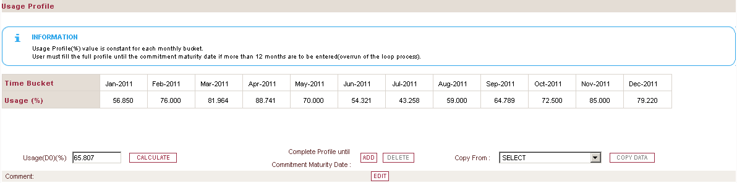
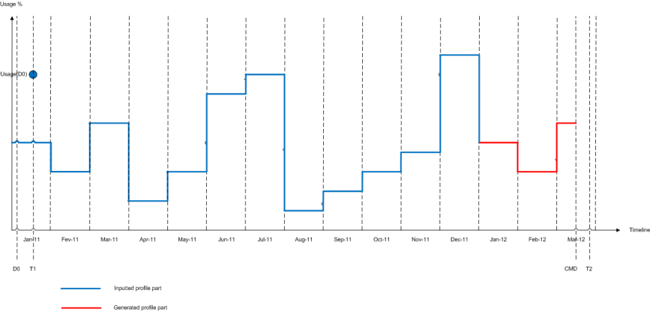
Liquidity project-Input Data> Portfolio>Input Management>Deal Forecast information (10/11)
Usage Profile is used (offset) from Max{Closing Date, Run Start Date}
User may define the deal’s Usage Profile over a full civil year or until its Commitment Maturity Date (CMD). First option will be preferred for seasonal deal because the profile would be reproduced periodically
Usage(D0): Percentage of the Program Limit at the Assessment Date that corresponds to the initial deal’s financing need
Usage (%): Percentage rate based on the current Program Limit value (adjusted for past and current payoffs and amortizing rate). It gives the deal’s financing need during the scenario
IM

Slide 50

Liquidity project-Input Data> Portfolio>Input Management>Deal Forecast information (11/11)
Usage Profile automated rules:
If the Usage Profile is defined over a full civil year, the Engine will create seasonality by reproducing it periodically until Min{CMD, Run End Date}
Usage(D0) value overrides the value from the monthly profile at scenario initiation
For sake of method synchronisation between Basel 3 and IM, if Run Start Date = D0, the Engine will set Usage(D0) = Bank Funding(D0) / Program Limit(D0)
For Revolving deals with switch to amortizing, the usage profile on switching date will last constantly as no more drawing will be allowed

Slide 51
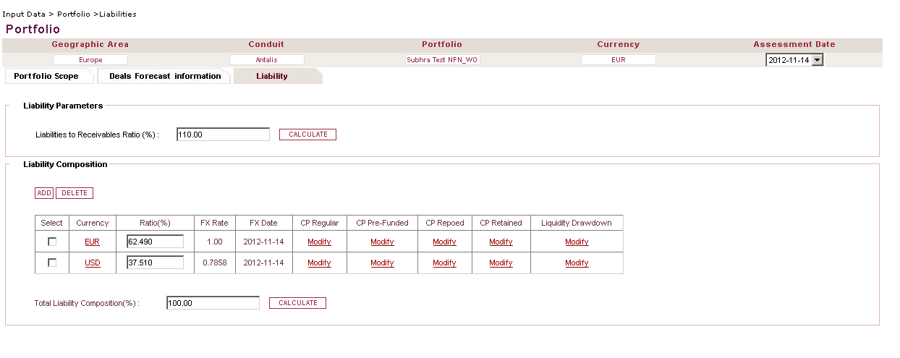
Liquidity project-Input Data> Portfolio>Input Management>Liability
Represent the ratio of liability to receivables including FX Rate and interests?
Cash flow calendar of different financing kind
Sum of liability ratio. Calculate button refresh the Total Liability composition
Represent the liability status of the conduit at the assessment date
Liabilities are defined by issued currency
B3
&
IM

Slide 52
Liquidity project-Input Data> Portfolio>Input Management>Liability
CP Regular: standard CP issued by conduit to match with current asset at the assessment date. Amounts to be entered by maturity and amounts due at maturity:
CP issued with a discount = Par Value is entered.
CP Issued at Par = Par Value + Interests is entered
CP Prefunded: Buffer of issued CP to anticipate crisis at the assessment date.
Currently not taken into account for Basel3. Under validation with DEVL to take CP prefunded into account for Basel3 Also
CP Retained: CP which are CP bought by the SG at the assessment date
CP Repoed: CP repoed to central bank (FED, BCE, BCA) at the assessment date
Liquidity draw down: LL or LC already drawn at the assessment date. Define at deal level
B3
&
IM
IM
IM
IM
IM

Slide 53
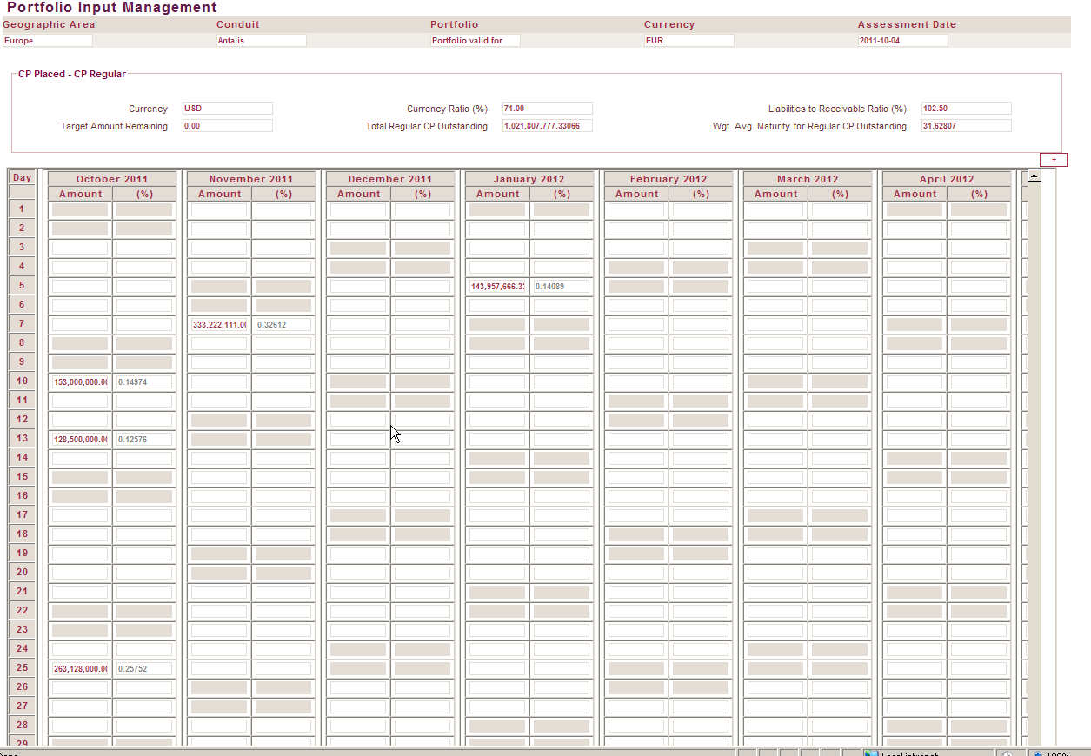
Liquidity project-Input Data> Portfolio>Input Management>Liability
Weighted average maturity for concerned CP Kind
Target amount remaining: target amount for the specific issued currency
(Currency ratio *total financing amount)Fxrate –total regular CP Outstanding
Can expand the calendar which displayed
9 months by default
Impossible to enter data
before assessment date
Total Regular CP outstanding : sum of inputted CP in cash flow calendar
(Currency ratio *total financing amount)Fxrate –total regular CP Outstanding
This is cash flow calendar, the amount should be signed. At maturity date the CP is positive
That mean the CP trade at D +X should be inputted at issued date with negative sign and at maturity date with positive amount

Slide 54
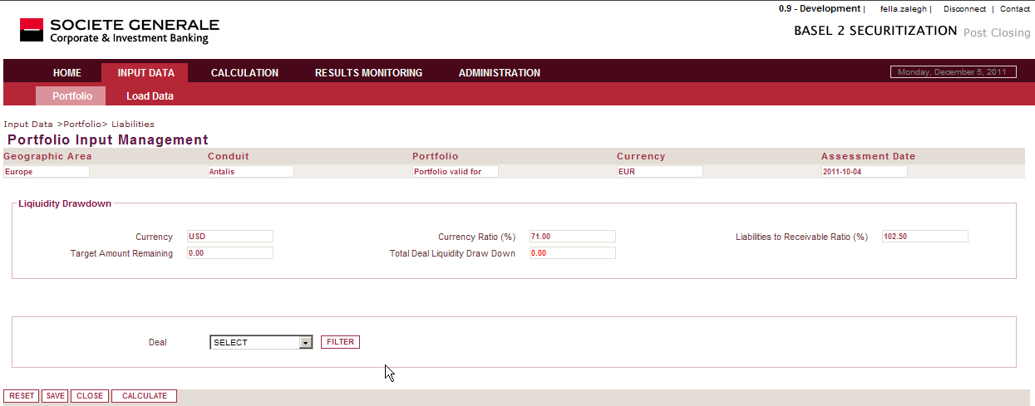
Liquidity project-Input Data> Portfolio>Input Management>Liability
Information at conduit level
Contrary to the CP, the liquidity drawdown should be defined per deal
Represent the amount of all lines which are drawn due to liquidity needs for each deal

Slide 55
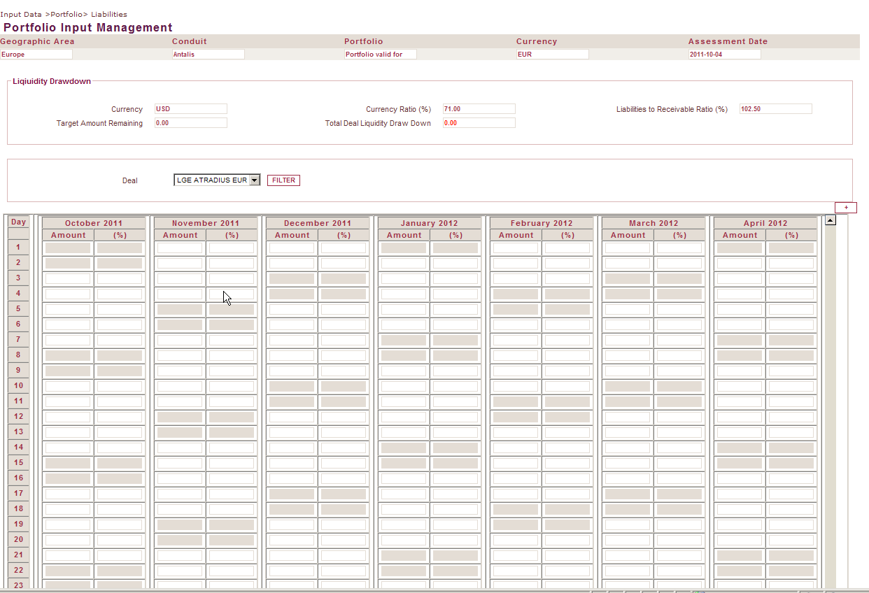
Liquidity project-Input Data> Portfolio>Input Management>Liability
Calendar of liquidity drawdown

Slide 56
Upstream Application impacts
In order to not scat entry in different application, inputs data are also available in Antalis 3 & CPC
Upstream application are considered as master of data
Data will be imported in B3S thanks to the input Loader
If link between upstream application and B3S are not available the data can be modified directly in B3S

Slide 57
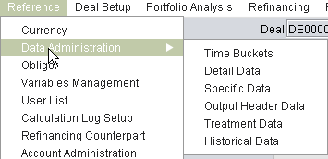
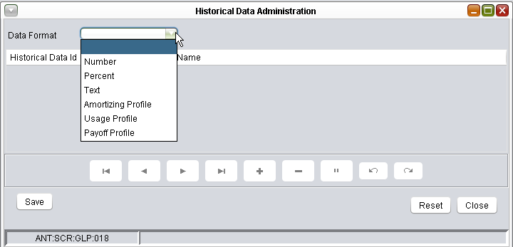
Upstream application impacts-Antalis
New features linked to Liquidity
Dynamic creation of Historical parameters
New format of Historical Parameters :
Amortizing
Usage
Payoff

Slide 58
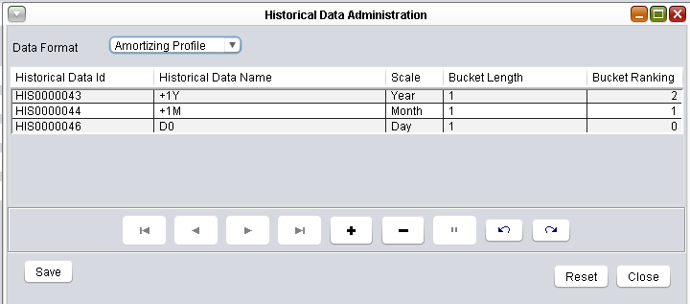
Upstream application impacts-Antalis
New historical data profiles (Amortizing, Usage, Payoff) will be defined by a name, scale, length and an index
NB : For Liquidity, index has to start from 0
IM

Slide 59
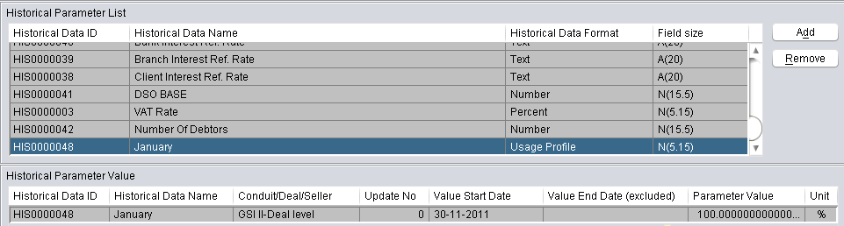
Upstream application impacts-Antalis
The historical Parameter newly created will be linked to any deal/seller level in order to create the necessary data for Liquidity forecast

Slide 60
Upstream application impacts-Antalis
Oper Tasks : (Based on first testing round)
Commitment maturity dates in Antalis are not up to date : → to be updated
Update SGBN B/S for deals without spreadsheet
Deactivated deals : → provide an up to date lists of deals to be deactivated in Antalis
ITECTasks :
Modify in the application the BDR ID for SGBN to the proper one (7314) (through a script)
Create an Historical Data (Excluded Seller) → set this data to Y for Traf sellers excepted Senior Antalis Note, set this data to Samsung FCT
Liaise with MO to ensure the scope of sellers to be taken into account for liquidity

Slide 61

Upstream application impacts-Antalis
Newly created Output data :
In order to reflect the entity data related to Liquidity (ex : SGBN), specific output data have been created
B3
&
IM

Slide 62
Upstream application impacts-Antalis
Actions based on the newly created Output data
ITEC : Modify the calculation spreadsheets /parameterization of the deals in Antalis
OPER : Verify the accuracy of the Output data

Slide 63
Upstream application impacts-CPC
Specific liquidity module has been created for asset data
The data about CP
CP Regular & CP Prefunded are already available on CPC
CP Repoed, Retained & Liquidity drawdown are not available in CPC. These data should be inputted directly in B3S (data required for Internal Method)

Slide 64
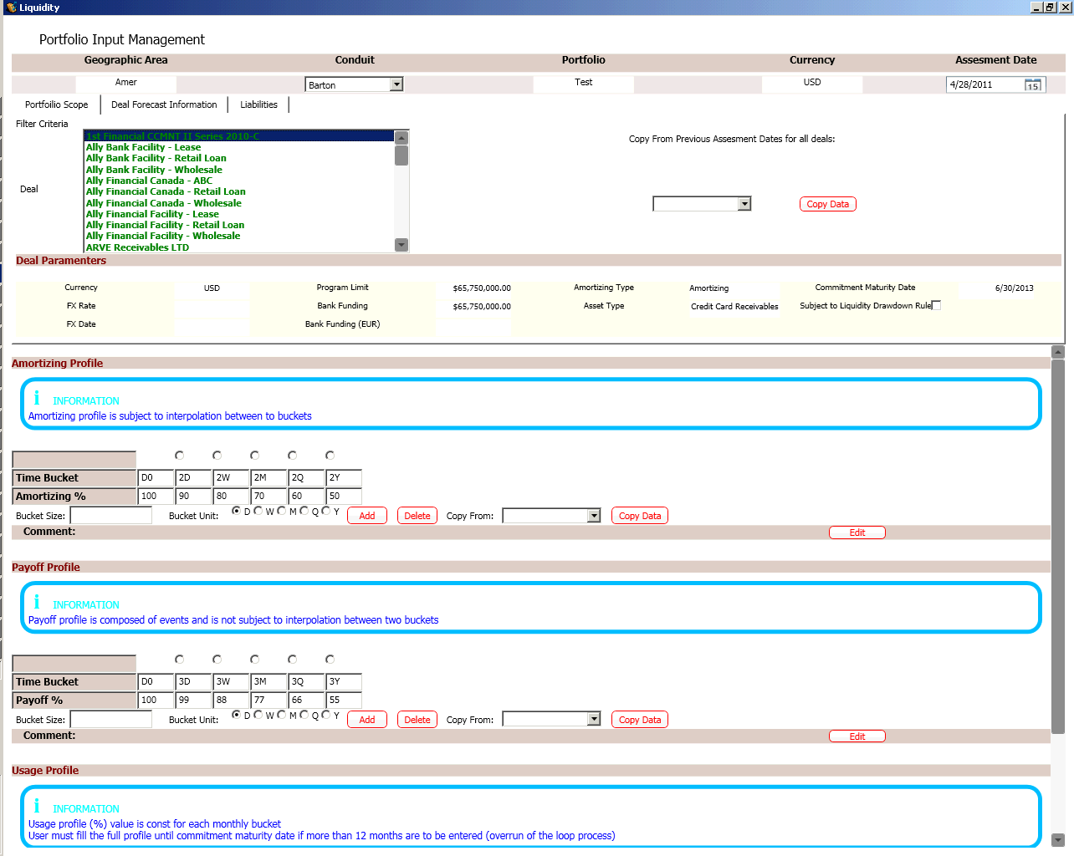
Upstream application impacts-CPC
Copy all deals for
given assessment date
B3
&
IM
IM
Deal parameter have same definition as B3S profile
All profiles have same definition as B3S profile
IM

Slide 65
Upstream application impacts-CPC
Oper Tasks : (Based on first testing round)
Commitment maturity dates have to be up to date : → to be updated
Completed deal should be deactivated in CPC & B3S

Slide 66
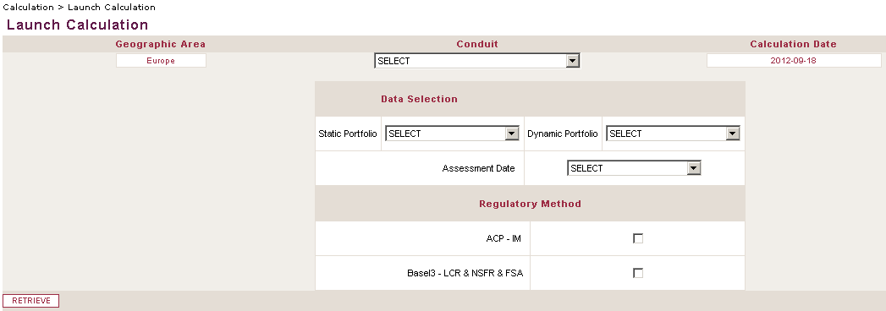
Liquidity project-Calculation>Launcher screen (1/2)
Data selection: Define the portfolio(s) and the calculations to be launched
IM-ACP: internal method
Basel3-LCR& NSFR & FSA: Basel3 methodology. Keep in mind that the LCR & NSFR is not calculated by B3S application but by DEVL calculator
Retrieve: depending on selected methodology, additional parameters will be requested. Then, data controls will be performed to ensure correct calculation
B3
&
IM

Slide 67
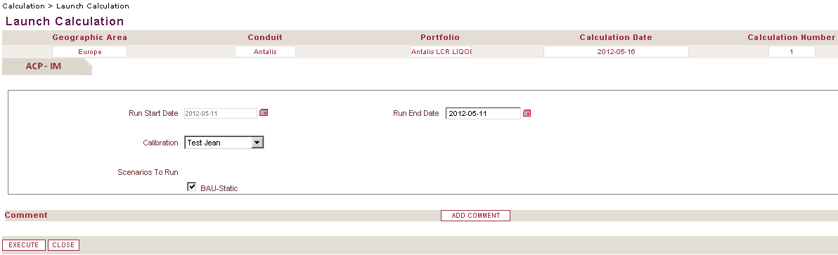
Liquidity project-Calculation>Launcher screen (2/2)
Run Start Date: Beginning date of the scenarii to run
Post-closing: The field becomes read-only and will be set with the portfolio’s Assessment Date in order to keep consistency between simultaneous calculations and LIQOR Sending
Simulation: If both Basel 3 and IM methods are requested, the field also becomes read-only and will be set with the portfolio’s Assessment Date
Run End Date: Ending date of the scenarii to run (constraint: Run End Date ≥ Run Start Date)
Calibration: Set of model parameters (Liquidity Drawdown and CP Events) to apply. Model parameters are defined per scenario
Scenarios To Run: Select the calibrated scenarii to run
IM

Slide 68
Liquidity project-Result Monitoring>Calculation Index
Displayed completed calculation
Filter: displayed results accordingly selected filter
Edit: Send to Liqor on demand is available
Click on send to Liqor Button
Pop up:
Frequency: defined for which frequency it should be sent: daily, weekly or monthly
Entity:
Conduit for Barton, Antalis, Ace or Home
Entity: other entity as SGBN

Slide 69
Agenda
Objectives
Business requirements
Functional architecture
Basel2 applications impacts
Basel3 & Liquidity
STP Process

Slide 70
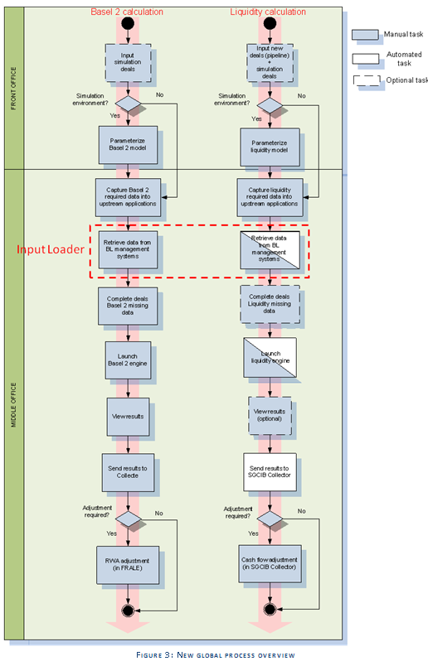
Process
Target: To have a Straight Through Processing (STP) chain
Process is by default fully automated: retrieve data from upstream applications, launch calculation and send results to SGCIB Collector
Manual inputs limited to model parameters and new deals: all other « transactional » data will be integrated to upstream applications
Calculation can be on-demand for simulation purpose

Slide 71
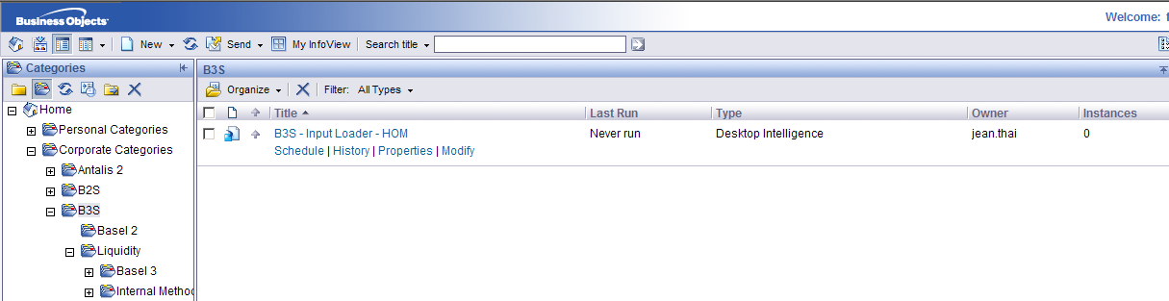
Business Object Reports
New organization of category
B3S: report common to Basel2 and Liquidity project
Basel2: report own to Basel2 requirements
Liquidity all reports concerned liquidity split in 2 categories
Basel3: report related to Basel 3
Internal method: Report related to Internal method only
Reports common to Basel3 and IM are under Liquidity

Slide 72
Business Object Reports
Auto Loader report has been reviewed to be common to Liquidity and Basel2 Import
Available under category: B3S named B3S-Input Loader-HOM
Reports for Liquidity
Basel 3 & FSA
L2S-BA3-Results LCR-HOM: it displays the results of Basel 3 calculation
Internal Method
L2S-IM-Calculation Inputs-HOM: whole set of inputs used for calculation including calibration profiles
L2S-IM-Results-Financing Needs-HOM: Financing needs forecast
L2S-IM-Entity Results-HOM: Entity gaps calculation result
L2S-IM-Fund Matching-HOM: Can review the scenarios launched and the matching between the financing needs and the funding sources
L2S-IM-Funding Solutions-HOM: Forecast of all funding solution stocks based on calibrated profiles and that match the portfolio’s funding needs

Slide 73
Questions
?

